Slide 1
K-map

Slide 2
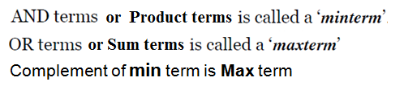
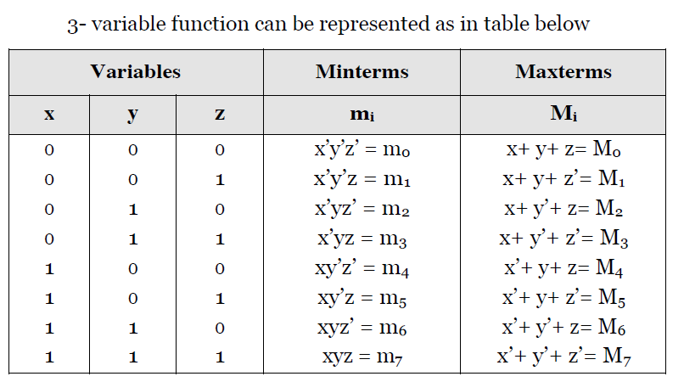
Min and Max Term

Slide 3
Design Procedure of Combinational Logic
Problem definition
Assign an input and output variables
Simplify the boolean expression
Implement Using the Logic gates

Slide 4
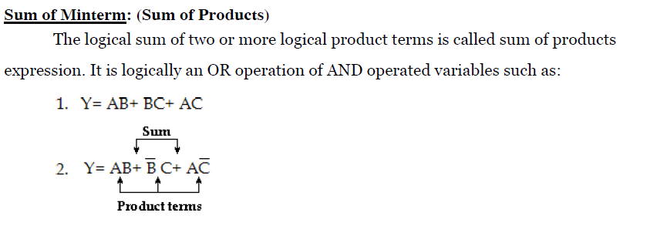

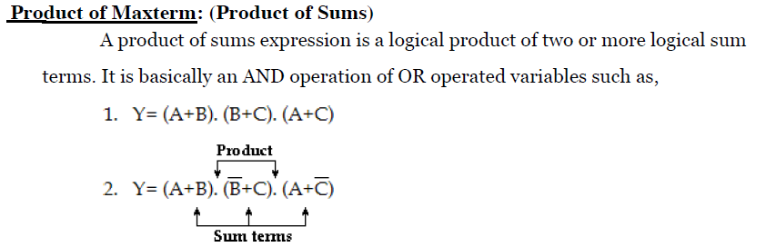
SOP and POS

Slide 5
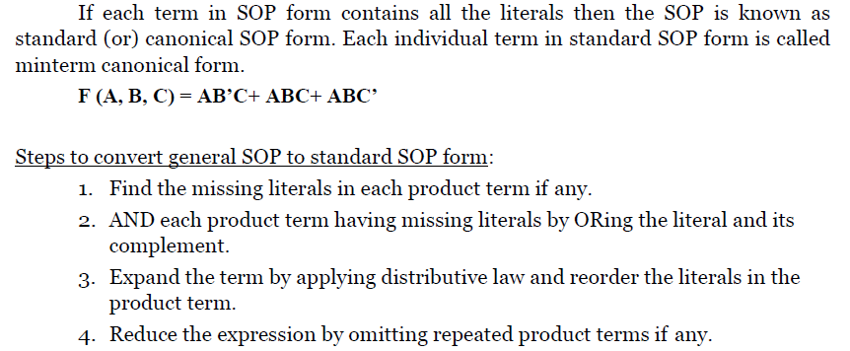
Canonical SOP or Standard SOP

Slide 6
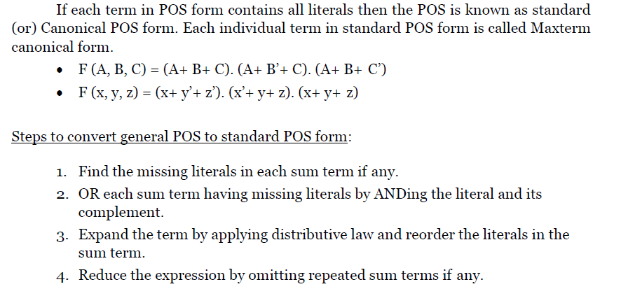
Canonical POS or Standard POS

Slide 7


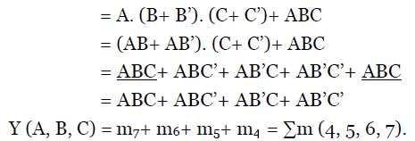



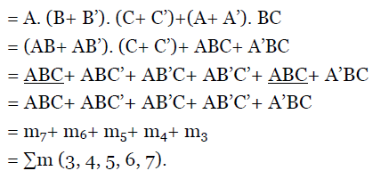
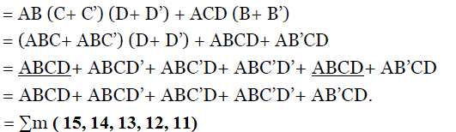
Problem
Obtain the Canonical SOP

Slide 8

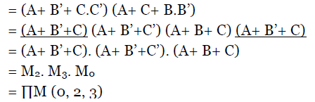

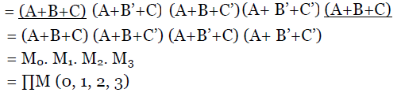
Problem
Obtain the Canonical POS

Slide 9
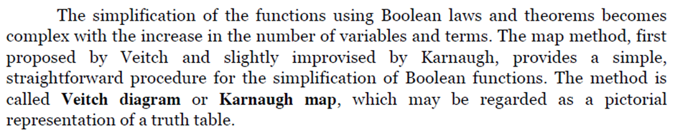
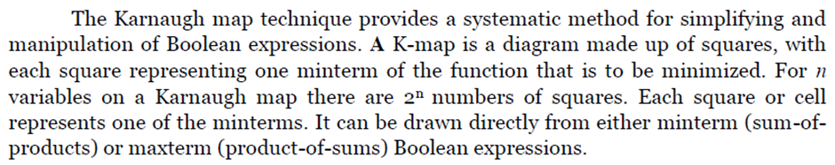
Karnaugh Map ( K – Map) Minimization

Slide 10
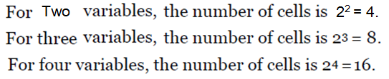
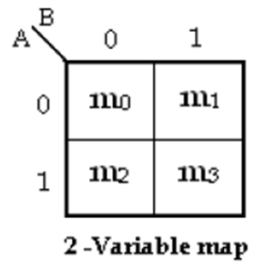
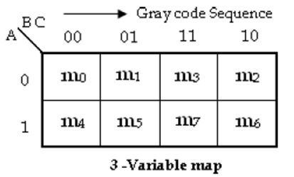
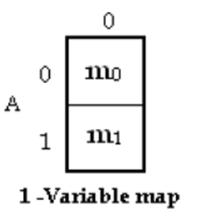
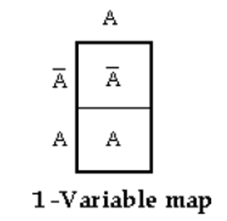
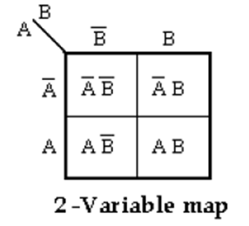
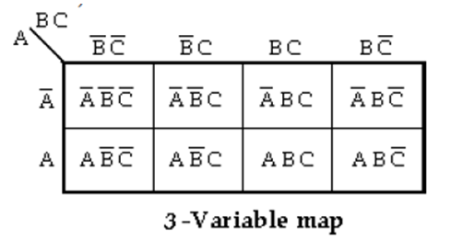
Two Variable, Three Variable, Four Variable K-Map

Slide 11
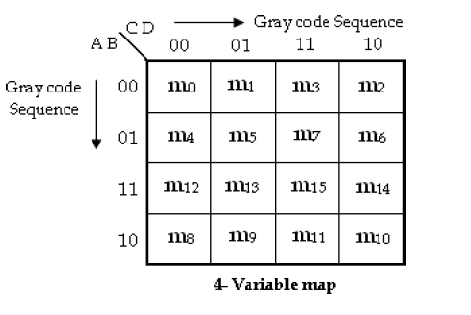
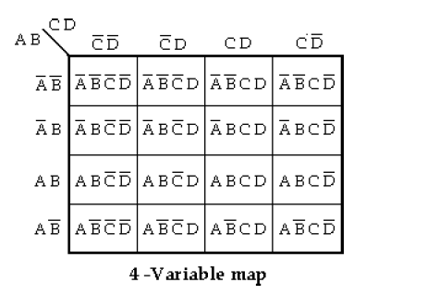
Four Variable K-Map

Slide 12
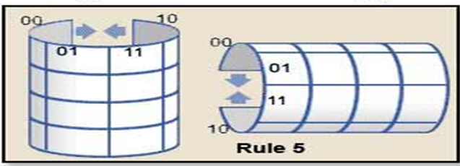
Grouping Cells for Simplification
Karnaugh Map Rules
1. Groups should contain as many ‘1’ cells (i.e. cells containing a logic 1) as possible and no blank cells.
2. Groups can only contain 1, 2 (Pair), 4 (Quad) , 8 (Octet) , 16 (Hexa) or 32... etc. cells (powers of 2).
3. A ‘1’ cell can only be grouped with adjacent ‘1’ cells that are immediately above, below, left or right of that cell; no diagonal grouping.
4. Groups of ‘1’ cells can overlap. This helps make smaller groups as large as possible, which is an advantage in finding the simplest solution.
5. The top/bottom and left/right edges of the map are considered to be continuous, so larger groups can be made by grouping cells across the top and bottom or left and right edges of the map.
6. There should be as few groups as possible.

Slide 13
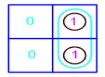

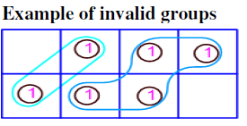
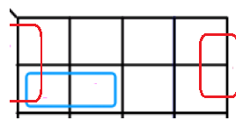
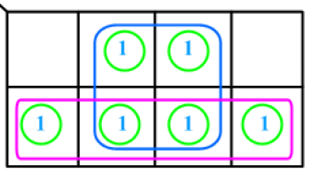
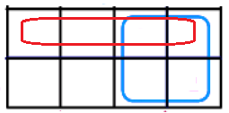
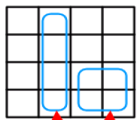
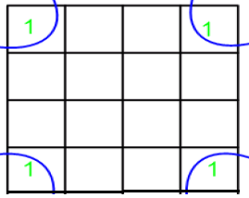
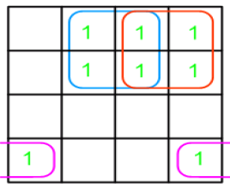
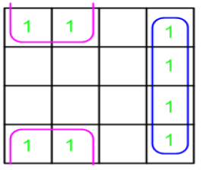
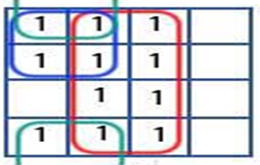
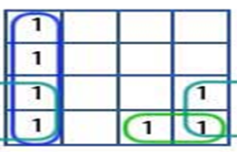
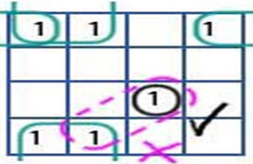
Grouping Cells for Simplification Cont..

Slide 14
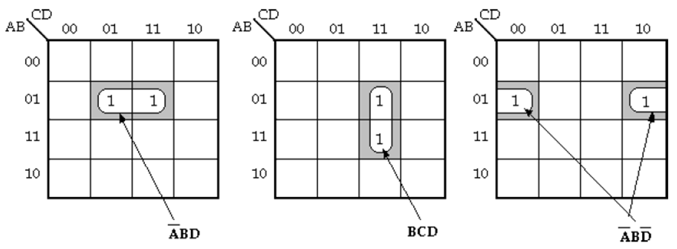
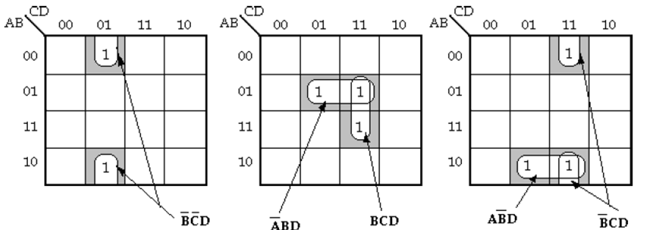
Grouping Cells for Simplification Cont..

Slide 15
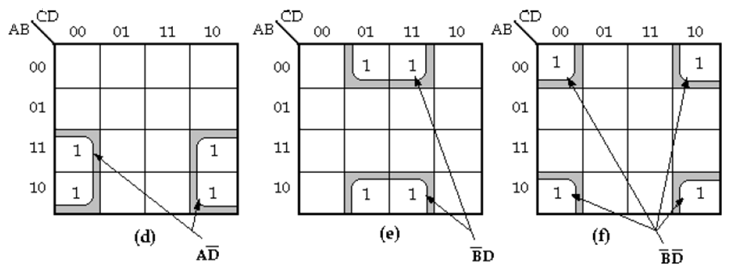
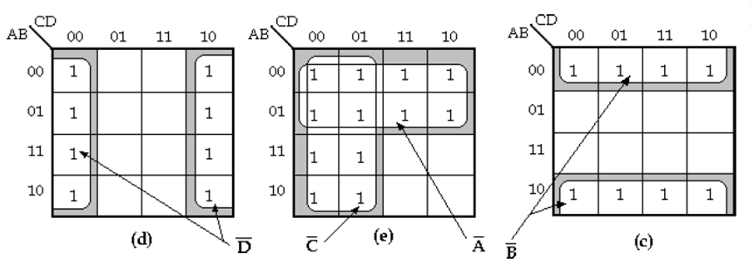
Grouping Cells for Simplification Cont..

Slide 16
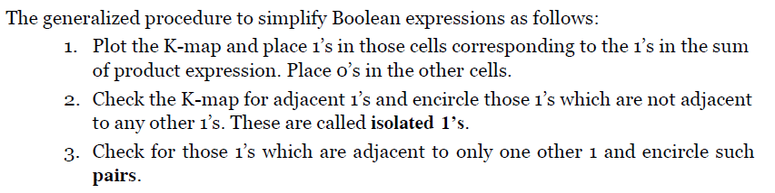
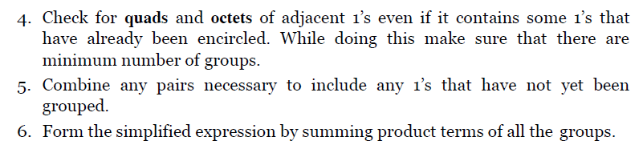

Slide 17

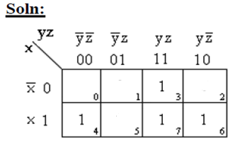
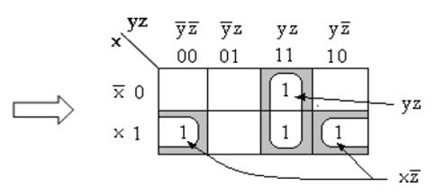

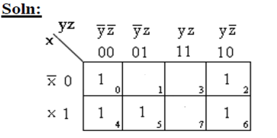
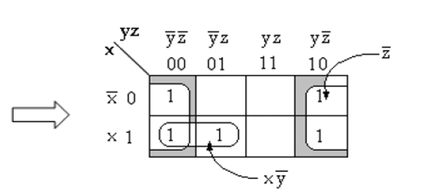

Problem

Slide 18
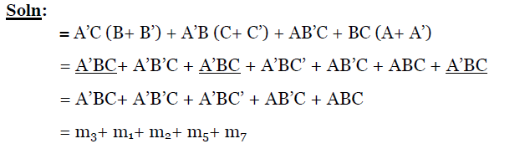

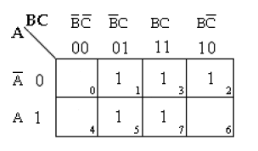
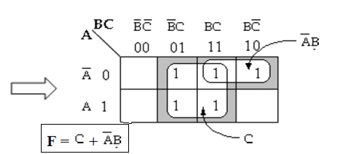

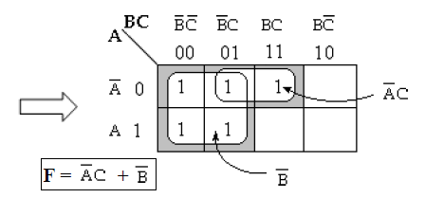
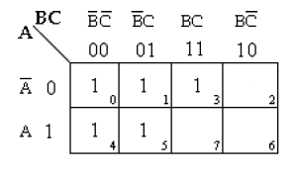

Slide 19








Slide 20








Slide 21



Home work : Simplify using K - Map

Slide 22



Slide 23



Problem – Simplify using K - Map

Slide 24



Problem – Simplify using K - Map

Slide 25

Home work : Simplify using K - Map

Slide 26


Don’t can be represent by ‘d’ or ‘X’

Slide 27






Simplify using K - Map

Slide 28






Simplify using K - Map

Slide 29

Home work : Simplify using K - Map

Slide 30


Five Variable K-Map

Slide 31

Grouping in 5 variable K-Map

Slide 32


Problem

Slide 33



Slide 34

Home Work

